Slide 1
Data Mining
Classification: Basic Concepts and Techniques
Lecture Notes for Chapter 3
Introduction to Data Mining
by
Tan, Steinbach, Karpatne, Kumar
© Tan,Steinbach, Karpatne, Kumar Introduction to Data Mining 02/03/2018 <number>

Slide 2
Classification: Definition
Given a collection of records (training set )
  Each record is by characterized by a tuple (x,y), where x is the attribute set and y is the class label
    x: attribute, predictor, independent variable, input
    y: class, response, dependent variable, output
Task:
  Learn a model that maps each attribute set x into one of the predefined class labels y

Slide 3
Examples of Classification Task
Task | Attribute set, x | Class label, y
Categorizing email messages | Features extracted from email message header and content | spam or non-spam
Identifying tumor cells | Features extracted from MRI scans | malignant or benign cells
Cataloging galaxies | Features extracted from telescope images | Elliptical, spiral, or irregular-shaped galaxies

Slide 4

General Approach for Building Classification Model

Slide 5
Classification Techniques
Base Classifiers
  Decision Tree based Methods
  Rule-based Methods
  Nearest-neighbor
  Neural Networks
  Naïve Bayes and Bayesian Belief Networks
  Support Vector Machines
Ensemble Classifiers
  Boosting, Bagging, Random Forests

Slide 6
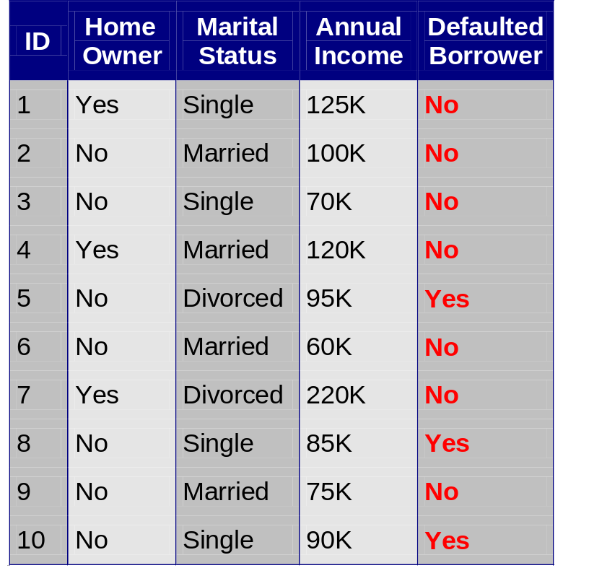
Example of a Decision Tree
categorical
categorical
continuous
class
Splitting Attributes
Home Owner
Yes
No
NO
MarSt
Single, Divorced
Married
Income
NO
< 80K
> 80K
NO
YES
Training Data
Model: Decision Tree
Notes:
Categorical data: Categorical data represent characteristics such as a person’s gender, marital status, hometown, or the types of movies they like. Categorical data can take on numerical values (such as “1” indicating male and “2” indicating female), but those numbers don’t have mathematical meaning. You couldn’t add them together, for example. (Other names for categorical data are qualitative data, or Yes/No data.)
Ordinal data mixes numerical and categorical data. The data fall into categories, but the numbers placed on the categories have meaning. For example, rating a restaurant on a scale from 0 (lowest) to 4 (highest) stars gives ordinal data. Ordinal data are often treated as categorical, where the groups are ordered when graphs and charts are made. However, unlike categorical data, the numbers do have mathematical meaning. For example, if you survey 100 people and ask them to rate a restaurant on a scale from 0 to 4, taking the average of the 100 responses will have meaning. This would not be the case with categorical data.

Slide 7
Another Example of Decision Tree
categorical
categorical
continuous
class
Single, Divorced
MarSt
Married
NO
Home Owner
Yes
No
NO
Income
< 80K
> 80K
NO
YES
There could be more than one tree that fits the same data!

Slide 8
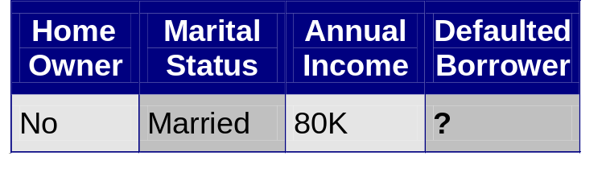
Apply Model to Test Data
Test Data
Start from the root of tree.
Home Owner
Yes
No
NO
MarSt
Single, Divorced
Married
Income
NO
< 80K
> 80K
NO
YES

Slide 9
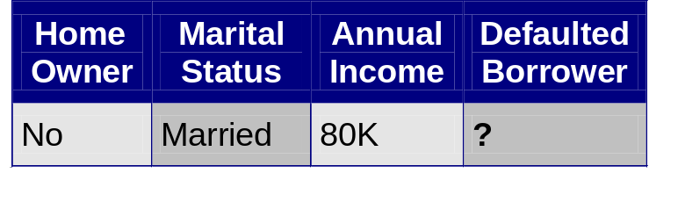
Apply Model to Test Data
Test Data
Home Owner
Yes
No
NO
MarSt
Single, Divorced
Married
Income
NO
< 80K
> 80K
NO
YES

Slide 10
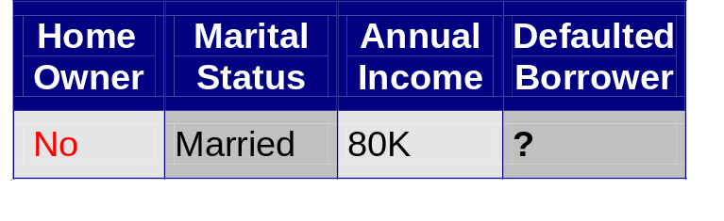
Apply Model to Test Data
Test Data
Home Owner
Yes
No
NO
MarSt
Single, Divorced
Married
Income
NO
< 80K
> 80K
NO
YES

Slide 11
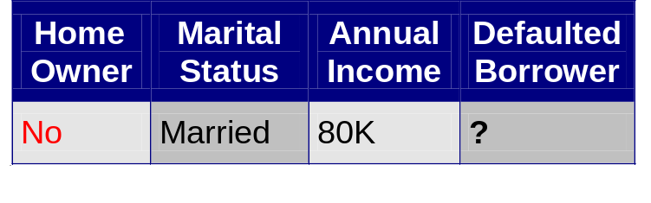
Apply Model to Test Data
Test Data
Home Owner
Yes
No
NO
MarSt
Single, Divorced
Married
Income
NO
< 80K
> 80K
NO
YES

Slide 12
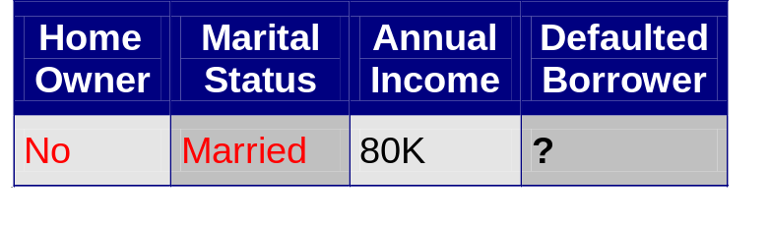
Apply Model to Test Data
Test Data
Home Owner
Yes
No
NO
MarSt
Single, Divorced
Married
Income
NO
< 80K
> 80K
NO
YES

Slide 13
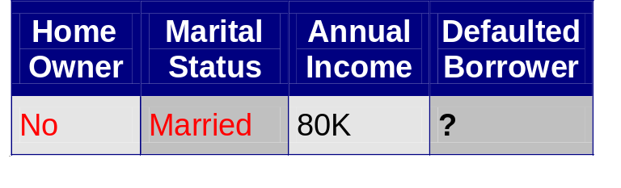
Apply Model to Test Data
Test Data
Home Owner
Yes
No
NO
MarSt
Single, Divorced
Married
Assign Defaulted to “No”
Income
NO
< 80K
> 80K
NO
YES

Slide 14

Decision Tree Classification Task
Decision Tree

Slide 15
Decision Tree Induction
Many Algorithms:
  Hunt’s Algorithm (one of the earliest)
  CART
  ID3, C4.5
  SLIQ,SPRINT

Slide 16
General Structure of Hunt’s Algorithm
Let D_{t} be the set of training records that reach a node t
General Procedure:
  If D_{t} contains records that belong the same class y_{t}, then t is a leaf node labeled as y_{t}
  If D_{t} contains records that belong to more than one class, use an attribute test to split the data into smaller subsets. Recursively apply the procedure to each subset.
D_{t}
?

Slide 17
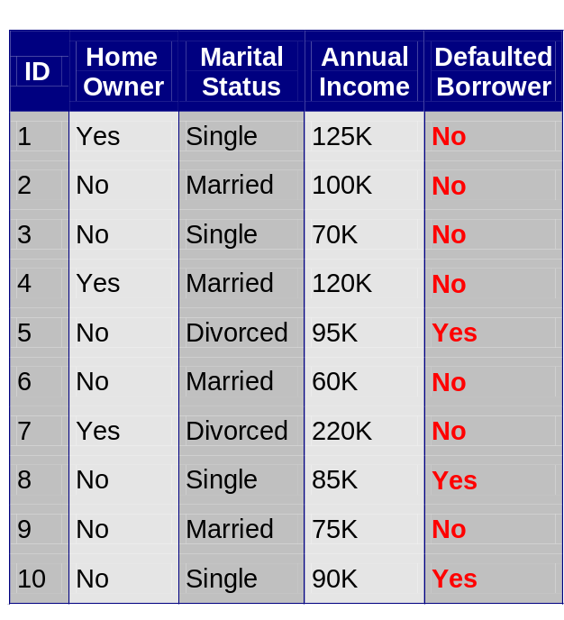
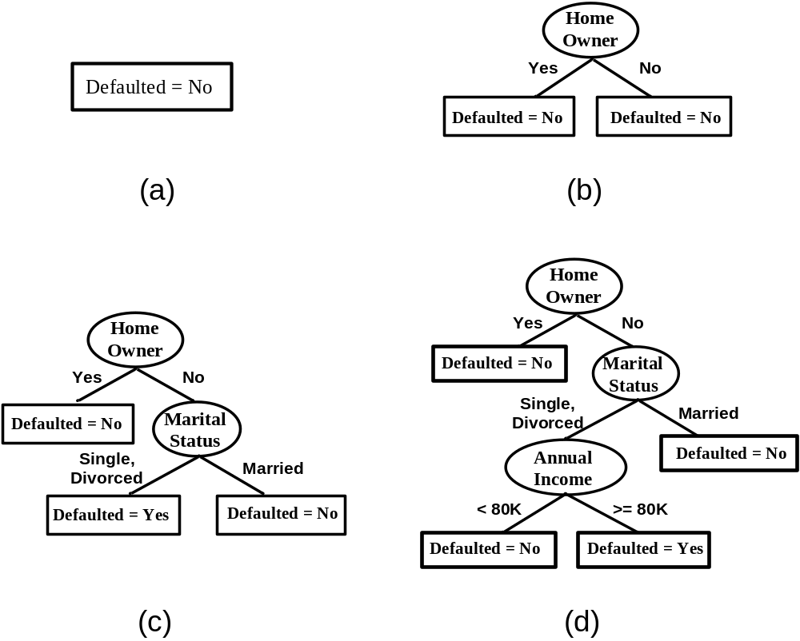
Hunt’s Algorithm
(7,3)
(3,0)
(4,3)
(3,0)
(3,0)
(3,0)
(1,3)
(3,0)
(1,0)
(0,3)

Slide 18
Hunt’s Algorithm
(7,3)
(3,0)
(4,3)
(3,0)
(3,0)
(3,0)
(1,3)
(3,0)
(1,0)
(0,3)

Slide 19
Hunt’s Algorithm
(7,3)
(3,0)
(4,3)
(3,0)
(3,0)
(3,0)
(1,3)
(3,0)
(1,0)
(0,3)

Slide 20
Hunt’s Algorithm
(7,3)
(3,0)
(4,3)
(3,0)
(3,0)
(3,0)
(1,3)
(3,0)
(1,0)
(0,3)

Slide 21
Design Issues of Decision Tree Induction
How should training records be split?
  Method for specifying test condition
    depending on attribute types
  Measure for evaluating the goodness of a test condition
How should the splitting procedure stop?
  Stop splitting if all the records belong to the same class or have identical attribute values
  Early termination

Slide 22
Methods for Expressing Test Conditions
Depends on attribute types
  Binary
  Nominal
  Ordinal
  Continuous
Depends on number of ways to split
  2-way split
  Multi-way split

Slide 23
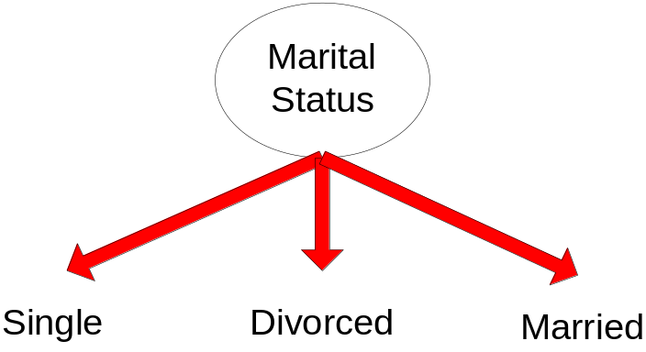
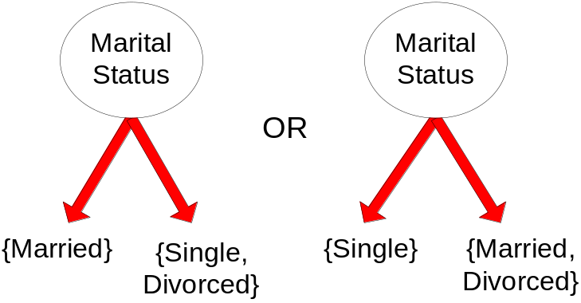
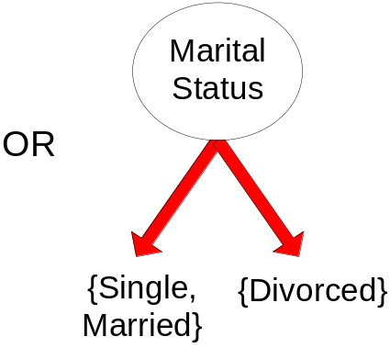
Test Condition for Nominal Attributes
Multi-way split:
  Use as many partitions as distinct values.
Binary split:
  Divides values into two subsets

Slide 24
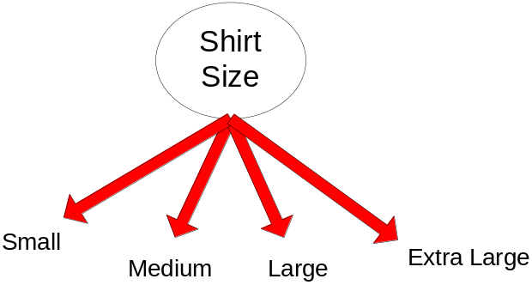
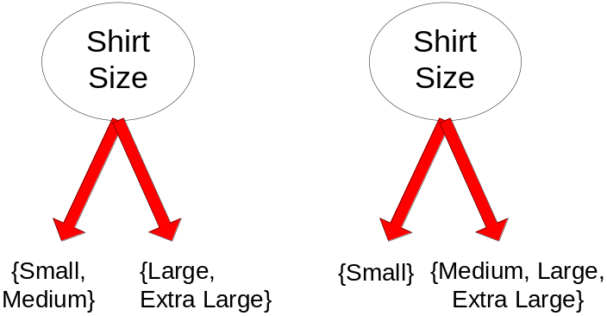
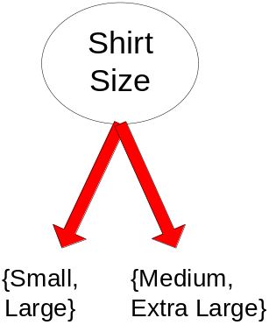
Test Condition for Ordinal Attributes
Multi-way split:
  Use as many partitions as distinct values
Binary split:
  Divides values into two subsets
  Preserve order property among attribute values
This grouping violates order property

Slide 25
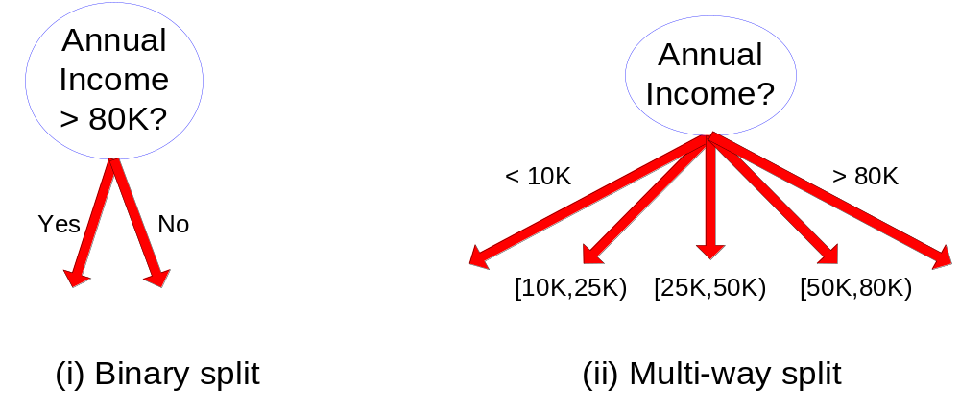
Test Condition for Continuous Attributes

Slide 26
Splitting Based on Continuous Attributes
Different ways of handling
  Discretization to form an ordinal categorical attribute
    Ranges can be found by equal interval bucketing, equal frequency bucketing (percentiles), or clustering.
    Static – discretize once at the beginning
    Dynamic – repeat at each node
  Binary Decision: (A < v) or (A ≥ v)
    consider all possible splits and finds the best cut
    can be more compute intensive

Slide 27
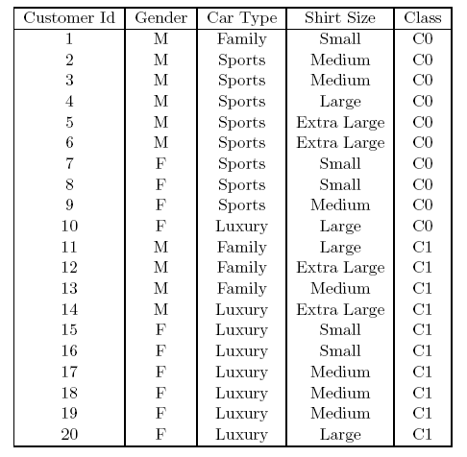
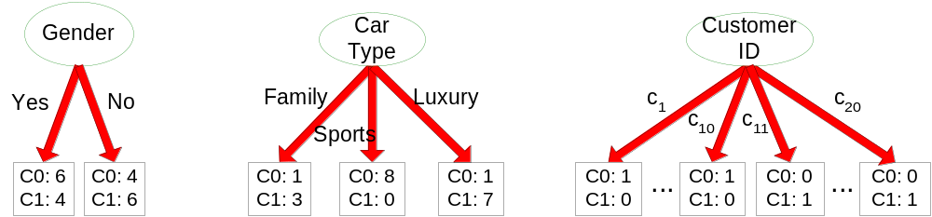
How to determine the Best Split
Before Splitting: 10 records of class 0,
10 records of class 1
Which test condition is the best?

Slide 28


How to determine the Best Split
Greedy approach:
  Nodes with purer class distribution are preferred
Need a measure of node impurity:
High degree of impurity
Low degree of impurity

Slide 29
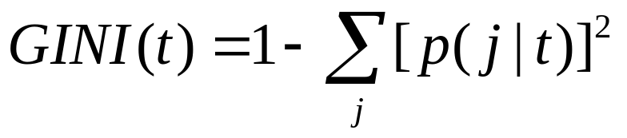


Measures of Node Impurity
Gini Index
Entropy
Misclassification error

Slide 30
Finding the Best Split
Compute impurity measure (P) before splitting
Compute impurity measure (M) after splitting
    Compute impurity measure of each child node
    M is the weighted impurity of children
Choose the attribute test condition that produces the highest gain
or equivalently, lowest impurity measure after splitting (M)
Gain = P – M

Slide 31



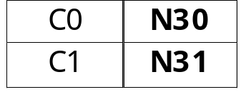

Finding the Best Split
Before Splitting:
P
A?
B?
Yes
No
Yes
No
Node N1
Node N2
Node N3
Node N4
M11
M12
M21
M22
M1
M2
Gain = P – M1 vs P – M2

Slide 32
Measure of Impurity: GINI
Gini Index for a given node t :
    (NOTE: p( j | t) is the relative frequency of class j at node t).
  Maximum (1 - 1/n_{c}) when records are equally distributed among all classes, implying least interesting information
  Minimum (0.0) when all records belong to one class, implying most interesting information

Slide 33




Measure of Impurity: GINI
Gini Index for a given node t :
    (NOTE: p( j | t) is the relative frequency of class j at node t).
  For 2-class problem (p, 1 – p):
    GINI = 1 – p² – (1 – p)² = 2p (1 – p)

Slide 34



Computing Gini Index of a Single Node
P(C1) = 0/6 = 0 P(C2) = 6/6 = 1
Gini = 1 – P(C1)² – P(C2)² = 1 – 0 – 1 = 0
P(C1) = 1/6 P(C2) = 5/6
Gini = 1 – (1/6)² – (5/6)² = 0.278
P(C1) = 2/6 P(C2) = 4/6
Gini = 1 – (2/6)² – (4/6)² = 0.444

Slide 35

Computing Gini Index for a Collection of Nodes
When a node p is split into k partitions (children)
where, n_{i} = number of records at child i,
n = number of records at parent node p.
Choose the attribute that minimizes weighted average Gini index of the children
Gini index is used in decision tree algorithms such as CART, SLIQ, SPRINT

Slide 36
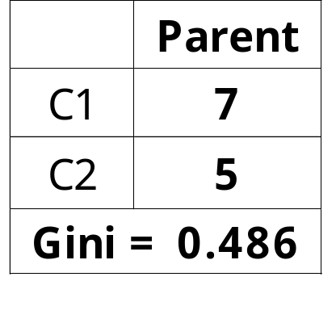
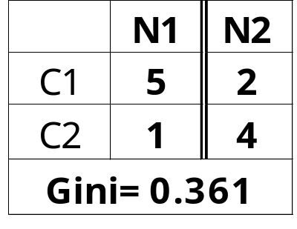
Binary Attributes: Computing GINI Index
P(C1) = 7/12 P(C2) = 5/12
Gini = 1 – (7/12)² – (5/12)² = 0.486
Splits into two partitions
Effect of Weighing partitions:
  Larger and Purer Partitions are sought for.
B?
Yes
No
Node N1
Node N2
Gini(N1)
= 1 – (5/6)² – (1/6)²
= 0.278
Gini(N2)
= 1 – (2/6)² – (4/6)²
= 0.444
Weighted Gini of N1 N2
= 6/12 * 0.278 +
6/12 * 0.444
= 0.361
Gain = 0.486 – 0.361 = 0.125
Notes:
6/12 means
5 + 1 = 6
2 + 4 = 6
5 + 1 + 2 + 4 = 12

Slide 37
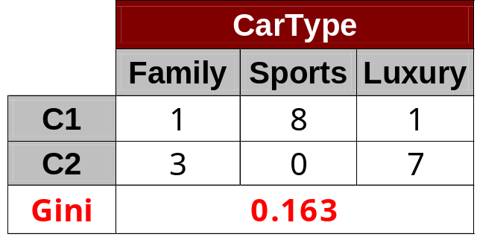
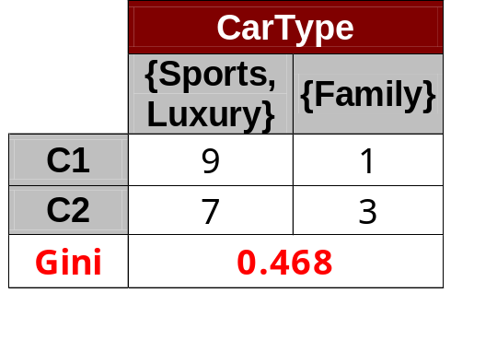
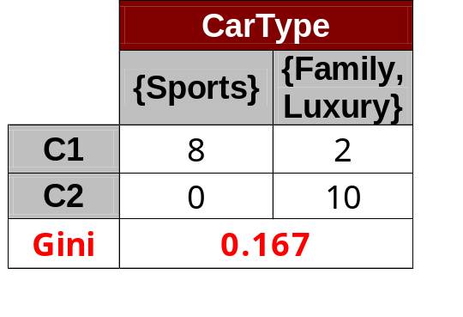
Categorical Attributes: Computing Gini Index
For each distinct value, gather counts for each class in the dataset
Use the count matrix to make decisions
Multi-way split
Two-way split
(find best partition of values)
Which of these is the best?

Slide 38
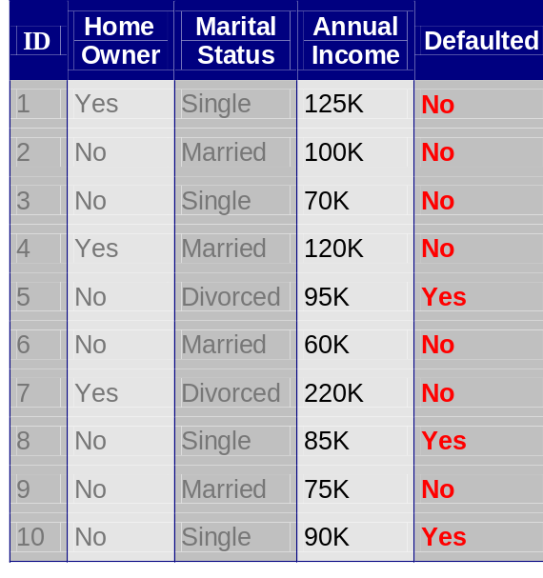
Continuous Attributes: Computing Gini Index
Use Binary Decisions based on one value
Several Choices for the splitting value
  Number of possible splitting values
  = Number of distinct values
Each splitting value has a count matrix associated with it
  Class counts in each of the partitions, A < v and A ≥ v
Simple method to choose best v
  For each v, scan the database to gather count matrix and compute its Gini index
  Computationally Inefficient! Repetition of work.
Annual Income ?
 | ≤ 80 | > 80
Defaulted Yes | 0 | 3
Defaulted No | 3 | 4

Slide 39
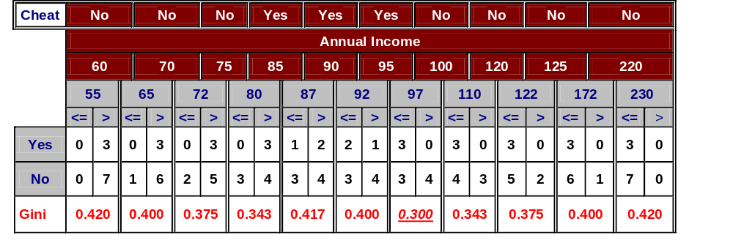
Continuous Attributes: Computing Gini Index...
For efficient computation: for each attribute,
  Sort the attribute on values
  Linearly scan these values, each time updating the count matrix and computing gini index
  Choose the split position that has the least gini index
Sorted Values
Split Positions

Slide 40
Continuous Attributes: Computing Gini Index...
For efficient computation: for each attribute,
  Sort the attribute on values
  Linearly scan these values, each time updating the count matrix and computing gini index
  Choose the split position that has the least gini index
Sorted Values
Split Positions

Slide 41
Continuous Attributes: Computing Gini Index...
For efficient computation: for each attribute,
  Sort the attribute on values
  Linearly scan these values, each time updating the count matrix and computing gini index
  Choose the split position that has the least gini index
Sorted Values
Split Positions

Slide 42
Continuous Attributes: Computing Gini Index...
For efficient computation: for each attribute,
  Sort the attribute on values
  Linearly scan these values, each time updating the count matrix and computing gini index
  Choose the split position that has the least gini index
Sorted Values
Split Positions

Slide 43
Continuous Attributes: Computing Gini Index...
For efficient computation: for each attribute,
  Sort the attribute on values
  Linearly scan these values, each time updating the count matrix and computing gini index
  Choose the split position that has the least gini index
Sorted Values
Split Positions

Slide 44
Measure of Impurity: Entropy
Entropy at a given node t:
    (NOTE: p( j | t) is the relative frequency of class j at node t).
    Maximum (log n_{c}) when records are equally distributed among all classes implying least information
    Minimum (0.0) when all records belong to one class, implying most information
  Information entropy is defined as the average amount of information produced by a stochastic source of data.
  Entropy based computations are quite similar to the GINI index computations

Slide 45

Computing Entropy of a Single Node
P(C1) = 0/6 = 0 P(C2) = 6/6 = 1
Entropy = – 0 log 0 – 1 log 1 = – 0 – 0 = 0
P(C1) = 1/6 P(C2) = 5/6
Entropy = – (1/6) log₂ (1/6) – (5/6) log₂ (1/6) = 0.65
P(C1) = 2/6 P(C2) = 4/6
Entropy = – (2/6) log₂ (2/6) – (4/6) log₂ (4/6) = 0.92
Notes:
Information entropy is defined as the average amount of information produced by a stochastic source of data.
The measure of information entropy associated with each possible data value is the negative logarithm of the probability mass function for the value.

Slide 46

Computing Information Gain After Splitting
Information Gain:
    Parent Node, p is split into k partitions;
    n_{i} is number of records in partition i
  Choose the split that achieves most reduction (maximizes GAIN)
  Used in the ID3 and C4.5 decision tree algorithms

Slide 47
Problem with large number of partitions
Node impurity measures tend to prefer splits that result in large number of partitions, each being small but pure
  Customer ID has highest information gain because entropy for all the children is zero

Slide 48


Gain Ratio
Gain Ratio:
    Parent Node, p is split into k partitions
    n_{i} is the number of records in partition i
  Adjusts Information Gain by the entropy of the partitioning (SplitINFO).
    Higher entropy partitioning (large number of small partitions) is penalized!
  Used in C4.5 algorithm
  Designed to overcome the disadvantage of Information Gain

Slide 49
Gain Ratio
Gain Ratio:
    Parent Node, p is split into k partitions
    n_{i} is the number of records in partition i
SplitINFO = 1.52
SplitINFO = 0.97
SplitINFO = 0.72
Introduction to Data Mining, 2nd Edition
Notes:
(9/16)log(9/16) = 0.56 * 0.83 = 0.46
(7/16)log(7/16) = 0.44 * 1.21 = 0.53
(1/4)log(1/4) = 0.25 * 2 = 0.5
(3/4)log(3/4) = 0.75 * 0.41 = 0.30
Weighted value = (0.99 + 0.8)/2
= 0.8 + 0.16
= 0.90
===================================================
(8/8)log(8/8) = 0
(0/8)log(0/8) = 0
(2/12)log(2/12) = 0.33 * 1.59 = 0.52
(10/12)log(10/12) = 0.83 * 0.26 = 0.21
Weighted value = 0.73

Slide 50
Measure of Impurity: Classification Error
Classification error at a node t :
  Maximum (1 - 1/n_{c}) when records are equally distributed among all classes, implying least interesting information
  Minimum (0) when all records belong to one class, implying most interesting information

Slide 51
Computing Error of a Single Node
P(C1) = 0/6 = 0 P(C2) = 6/6 = 1
Error = 1 – max (0, 1) = 1 – 1 = 0
P(C1) = 1/6 P(C2) = 5/6
Error = 1 – max (1/6, 5/6) = 1 – 5/6 = 1/6
P(C1) = 2/6 P(C2) = 4/6
Error = 1 – max (2/6, 4/6) = 1 – 4/6 = 1/3

Slide 52
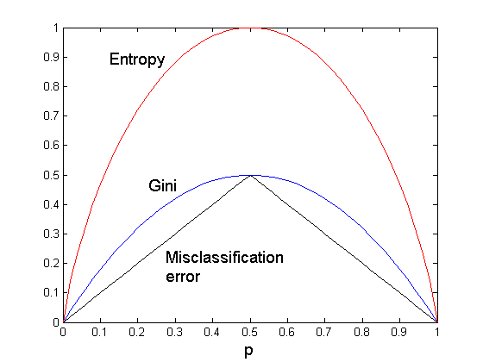
Comparison among Impurity Measures
For a 2-class problem:

Slide 53

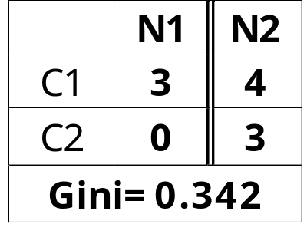
Misclassification Error vs Gini Index
A?
Yes
No
Node N1
Node N2
Gini(N1)
= 1 – (3/3)² – (0/3)²
= 0
Gini(N2)
= 1 – (4/7)² – (3/7)²
= 0.489
Gini(Children)
= 3/10 * 0
+ 7/10 * 0.489
= 0.342
Gini improves but error remains the same!!

Slide 54
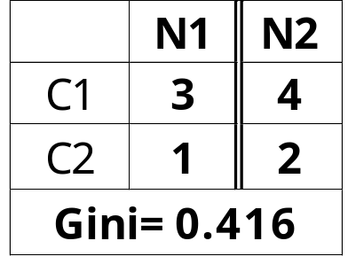
Misclassification Error vs Gini Index
A?
Yes
No
Node N1
Node N2
Misclassification error for all three cases = 0.3 !

Slide 55
Decision Tree Based Classification
Advantages:
  Inexpensive to construct
  Extremely fast at classifying unknown records
  Easy to interpret for small-sized trees
  Robust to noise (especially when methods to avoid overfitting are employed)
  Can easily handle redundant or irrelevant attributes (unless the attributes are interacting)
Disadvantages:
  Space of possible decision trees is exponentially large. Greedy approaches are often unable to find the best tree.
  Does not take into account interactions between attributes
  Each decision boundary involves only a single attribute

Slide 56
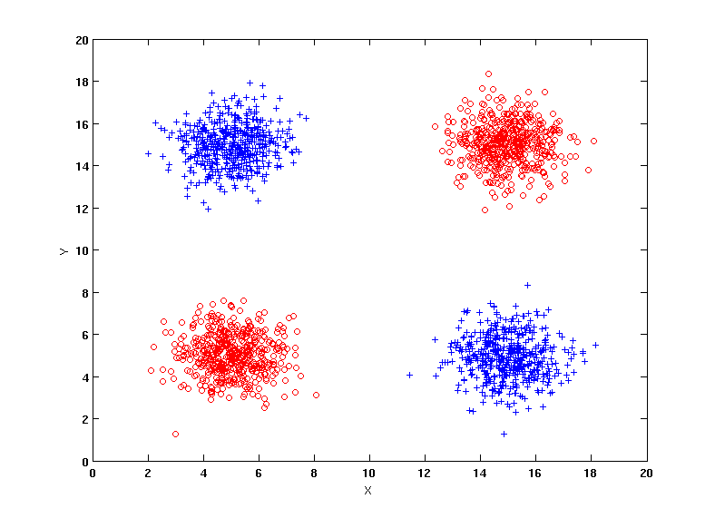
Handling interactions
+ : 1000 instances
o : 1000 instances
Entropy (X) : 0.99
Entropy (Y) : 0.99
Y
X

Slide 57
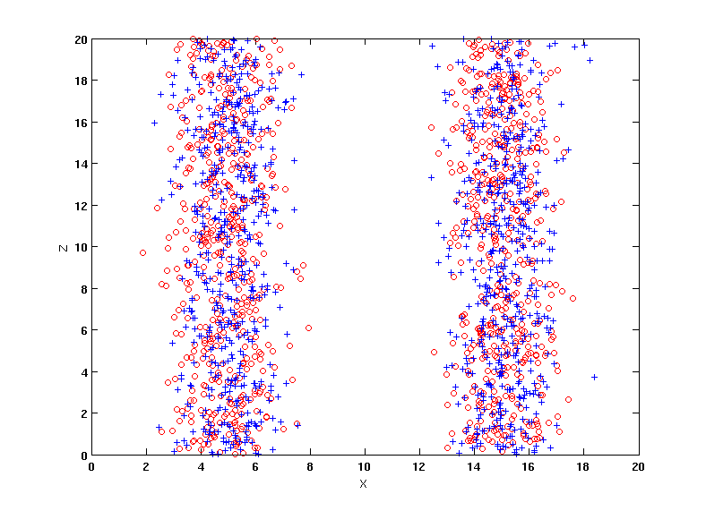
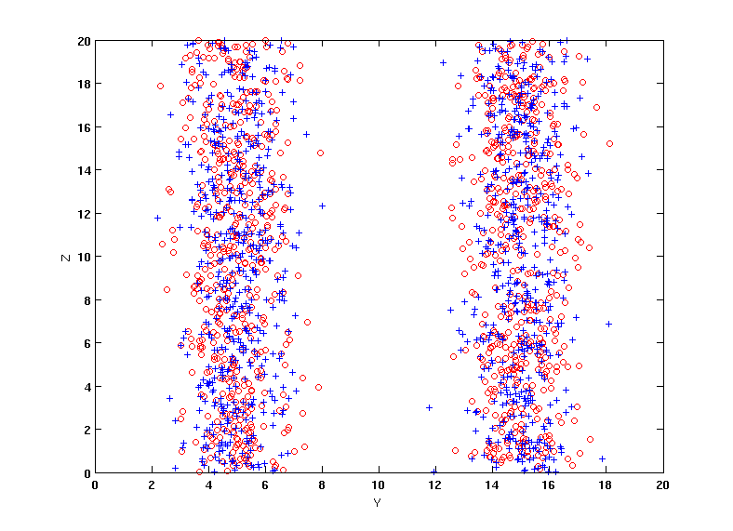
Handling interactions
+ : 1000 instances
o : 1000 instances
Adding Z as a noisy attribute generated from a uniform distribution
Entropy (X) : 0.99
Entropy (Y) : 0.99
Entropy (Z) : 0.98
Attribute Z will be chosen for splitting!
Y
X
Z
Z
X
Y

Slide 58
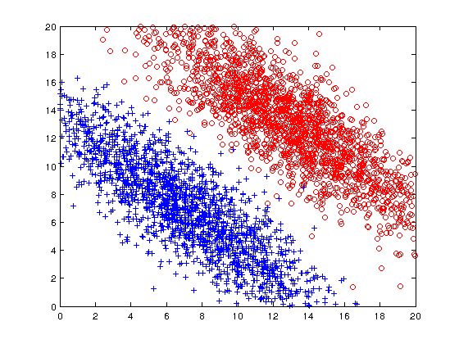
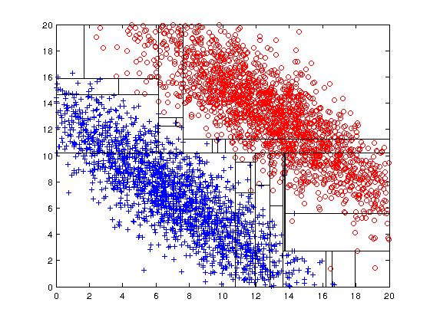
Limitations of single attribute-based decision boundaries
Both positive (+) and negative (o) classes generated from skewed Gaussians with centers at (8,8) and (12,12) respectively.

